Slide 1
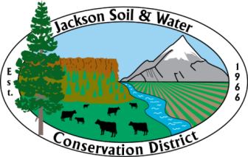
National Water Quality Initiative Community Meeting 11/03/2022 Eagle Point Middle School Hosted by Eagle Point Irrigation District
JSWCD: MEGHAN MONTGOMERY; PAUL DEMAGGIO; HANNAH SATEIN
RRWC: JOHN SPEECE

Slide 2
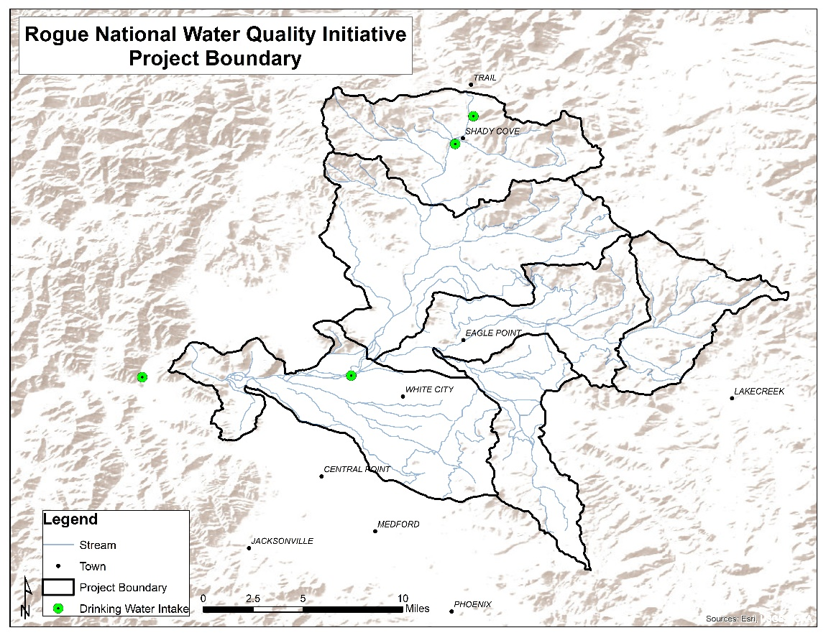
Meeting Overview
Presentation
Who we are, what we do
(JSWCD, RRWC, NRCS)
Project Background
History
Data Collection
Outreach
Project Examples
Practices

Slide 3
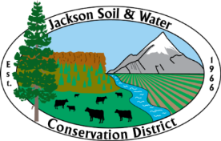
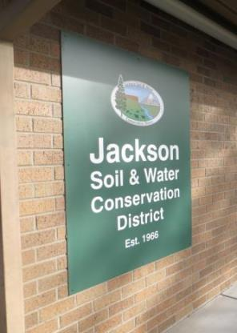
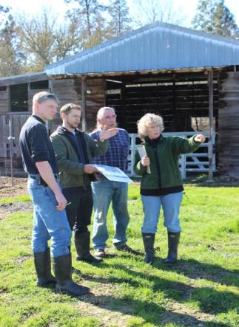
Who is Jackson SWCD?
Non-regulatory special district serving Jackson County
Supported by property tax measure
Services
Technical Assistance
Site visits, project planning, project design, information
Financial Assistance
District grant programs
External grants
Education
Outreach
Monitoring

Slide 4
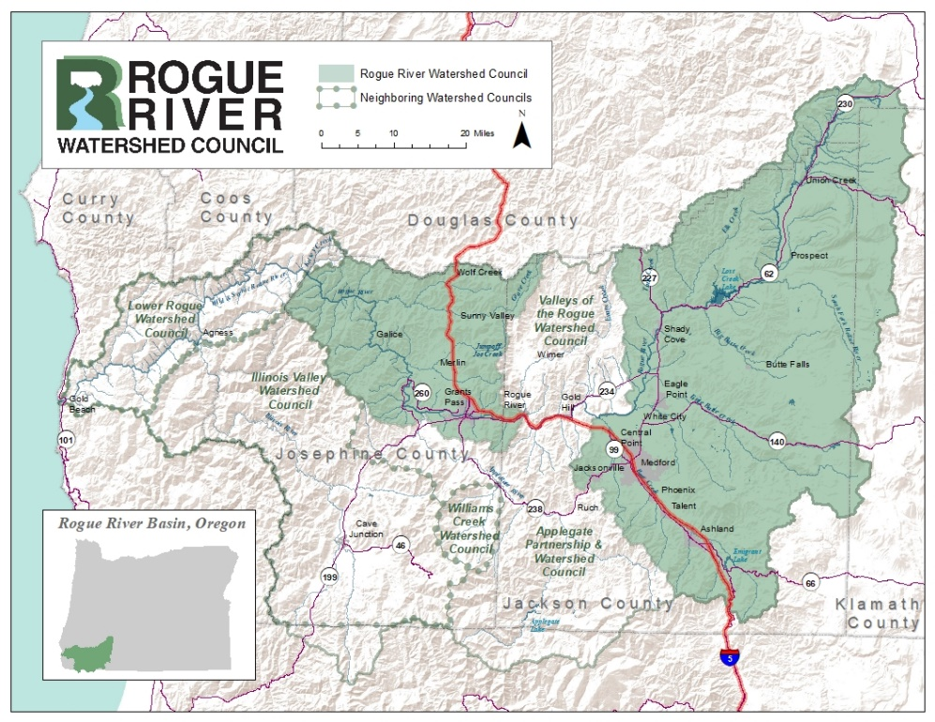
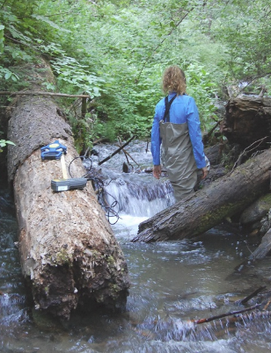
Who is Rogue River WC?
Non-regulatory non-profit organization
Work with voluntary landowners
Recognized by local government
Funded through grants and donations
Project planning and implementation
Monitoring programs

Slide 5
JSWCD and RRWC Work Collaboratively
Wagner Creek Strategic Implementation Area
Landowners:11
Acres in project: 12
Number of riparian plants: 9,000 trees, 700 cuttings
Miles of newly accessed habitat
Other practices: Manure storage facility, irrigation conversion, exclusion fencing, two diversion structures, plant irrigation and stewardship

Slide 6
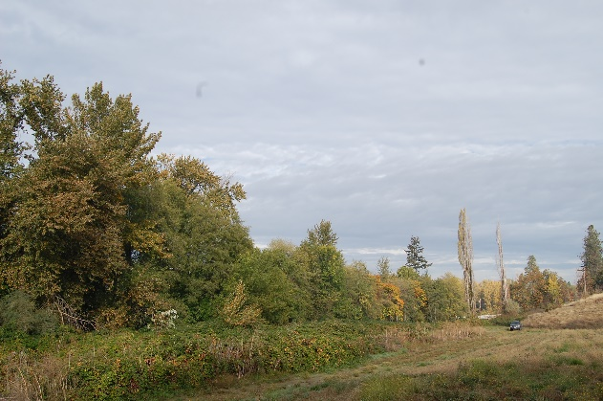
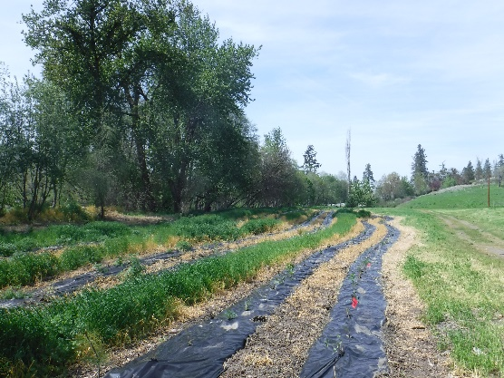
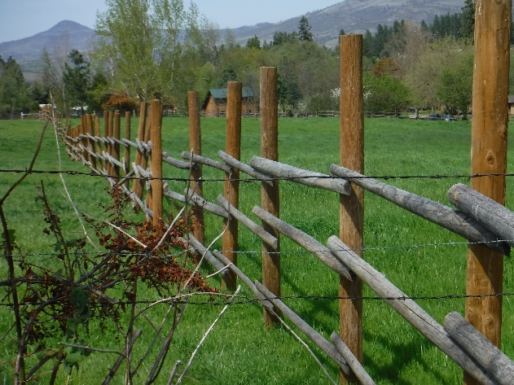
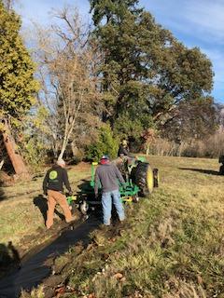
JSWCD and RRWC Work Collaboratively

Slide 7
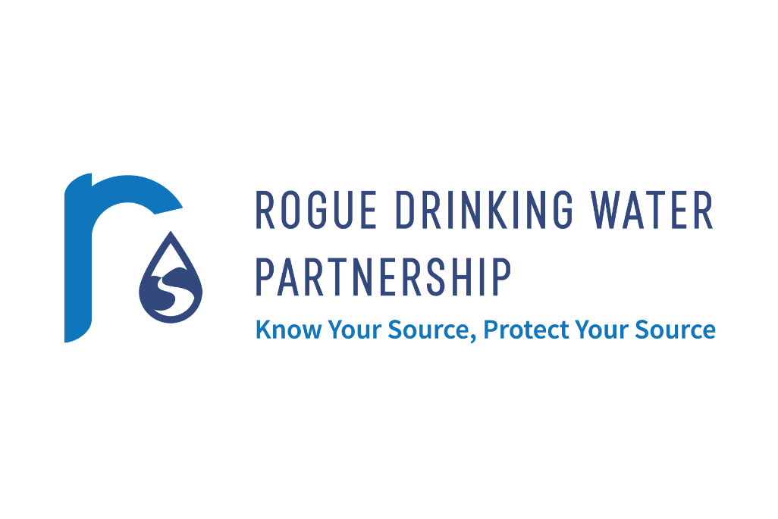
NWQI Project Background
Nationwide partnership among local, state, and federal partners to improve and protect water quality through voluntary conservation.
Rogue Drinking Water Partnership
Protect source waters to improve drinking water quality and protect beneficial uses in the Rogue River Basin.
Collaborative partnership concerned with protecting the quality and quantity of our drinking water supplies

Slide 8
Project Background
What Is Source Water?
Source water refers to sources of water (such as rivers, streams, lakes, reservoirs, springs, and groundwater) that provide water to public drinking water supplies and private wells.
Why Protect Source Water?
Protecting source water can reduce risks by preventing exposures to contaminated water.
Protecting source water from contamination helps reduce treatment costs.
Protecting source water benefits fish and wildlife and other aquatic species.

Slide 9
Project Background
What Are Some Examples of Source Water Protection?
Riparian zone restoration to reduce runoff pollution;
Stream bank stabilization to reduce sedimentation;
Best management practices for agricultural and forestry activities or stormwater control;
Land protection/easements;
Local ordinances to limit certain activities in source water or wellhead protection areas;
Developing emergency response plans; and
Educating local industry, businesses, and citizens on pollution prevention and source water protection.

Slide 10
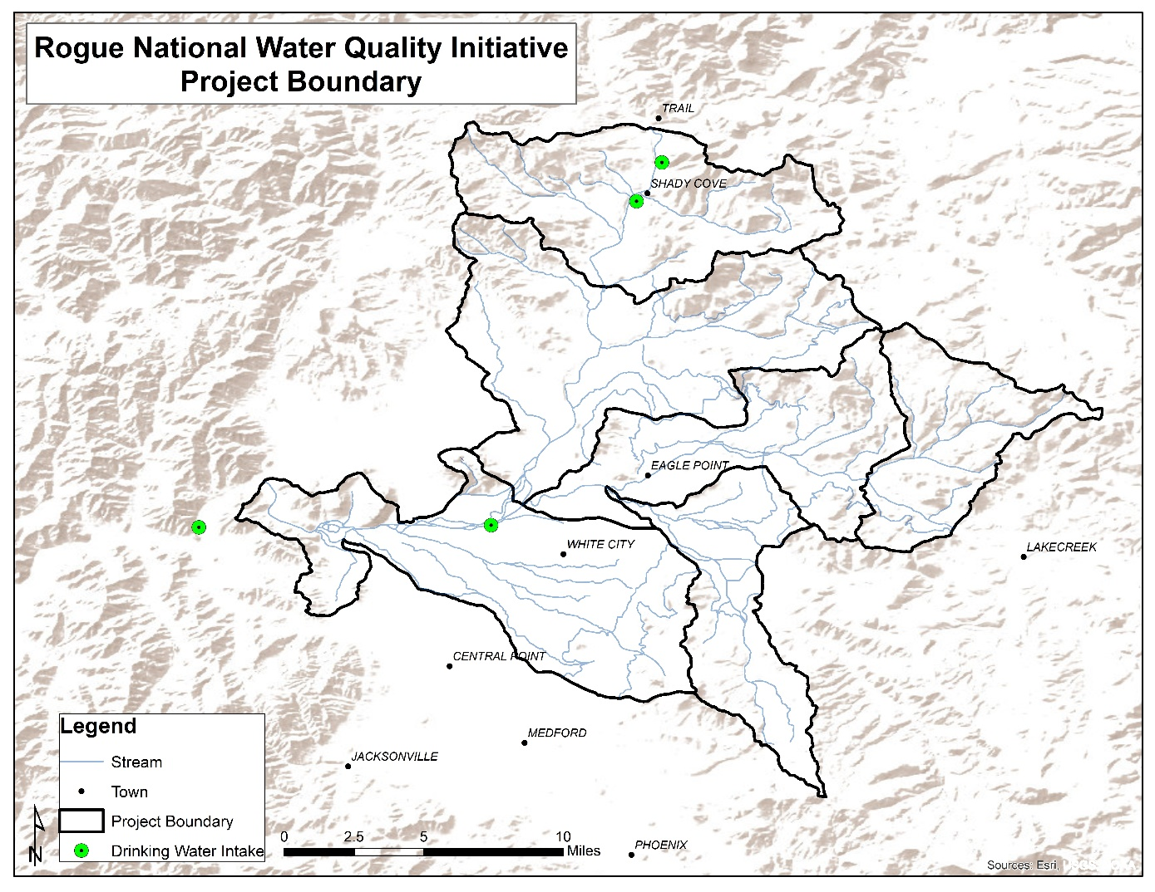
Project Background

Slide 11
Project Background
Goals and Objectives
Identify and prioritize key critical areas within the SWP area.
Identify practices that will address agricultural threats to water quality within the SWP area.
Prioritize education and outreach to agricultural producers within the SWP area.
Reduce levels of nutrients, sediment, and pesticides from agricultural sources and increase riparian buffers within the SWP area.

Slide 12
Outreach Strategy: Survey and Landowner Open Houses
We asked all owners of irrigated land in the project area what their management priorities were, what natural resources they had on their properties, and what their level of interest was in working with entities like JSWCD or RRWC on addressing natural resource and production issues.
Land use: what ag product?
Top priorities for improvements -infrastructure condition
Riparian area management
Interest in technical and financial assistance
Local environmental concerns: water quality
Majority interested in working with agencies/orgs on improvements

Slide 13
Priority Resource Concerns
Primary Priority
Irrigation Infrastructure
Grazing Management & Pasture Productivity
Crop Production
Streamside Vegetation
Livestock Infrastructure
Secondary Priorities
Irrigation Infrastructure
Grazing Management & Pasture Productivity
Livestock Infrastructure
Crop Production
Wildlife Habitat
Invasive Species
Streamside Vegetation
Wildfire Resilience

Slide 14
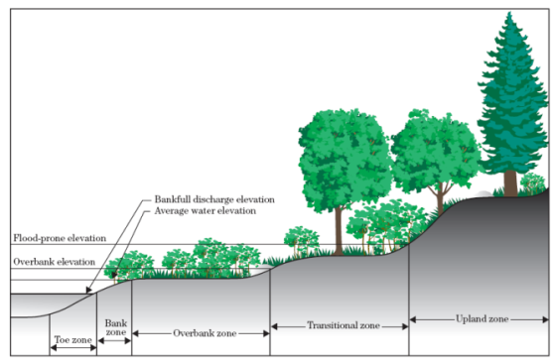
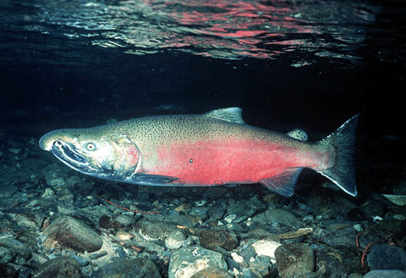
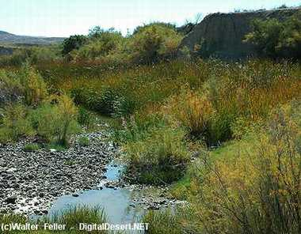
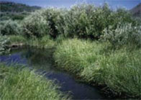
Benefits of Healthy Riparian Buffers
Reduced water pollution
Soil conservation through erosion control
High water protection
Improved fish and wildlife habitat
Notes:
Reduced water pollution
Intercepts surface runoff and filters sediment
Research has shown that riparian vegetation can remove up to 90% of unused nitrogen from croplands
Soil conservation through erosion control
Protects vulnerable soils
Roots strengthen and stabilize stream banks
Above ground vegetation intercepts water force and energy
High water protection
Slows water velocities
Absorbs water flows and energy
Improved fish and wildlife habitat
Trees and shrubs create cover and nesting habitat
Fallen vegetation and insects contribute to the primary food source for the aquatic ecosystem

Slide 15
Ways to Protect Riparian Areas
Planting native vegetation, filter strips
Fencing
Managed grazing
Off-channel watering & shade
Hardened crossings & access points
Manure management & storage
Return flow reduction or reuse
Irrigation conversion
Notes:
Most of these seem to focus on keeping livestock away from streams. But really what you’re doing with these tools is just managing access.

Slide 16
Protecting Water Quality
Agriculture can have negative impacts on surface water quality.
Improving farm and property management helps ensure that surface water stays clean—and benefits crop and livestock productivity as well.
Minimize irrigation runoff
Implement practices that ensure runoff is cleaner & cooler than it would otherwise be.
Manage irrigation water
Manage livestock: grazing, access to streams, and feeding and wintering areas
Upgrade irrigation systems, usually from flood to sprinkler

Slide 17
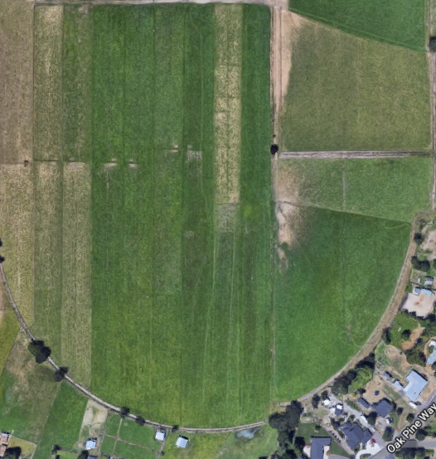
Managed Grazing
Moving livestock between paddocks gives more control over animal impact to pastures
Increase forage stand cover and density
Give pastures adequate rest and regrowth time
Improve forage quality
Benefit livestock health

Slide 18
Off-Channel Stockwater Systems
Stock water systems ensure a clean water source and delivery system for livestock
Provide stock water away from stream channels
Protect irrigation ditch infrastructure
Allow better grazing management
Improves livestock health and production

Slide 19
Heavy Use Area Protection
Provide a stable, non-eroding surface for areas frequently used by livestock, people, or vehicles
Minimizes or eliminates formation of mud in high-traffic areas
Keeps livestock cleaner and healthier
Reduces odors, flies, mosquitos
Makes management tasks easier and more efficient

Slide 20
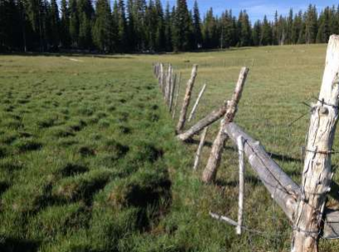
Sacrifice Lot or Winter Pasture
Small, non-grazeable area used for livestock feeding or horse exercise during non-growing (winter) months or during drought
Protects pasture quality during wet winter months
Prevents creation of mud in pastures, prevents compaction and hummocking
Allows animals freedom of movement and exercise

Slide 21
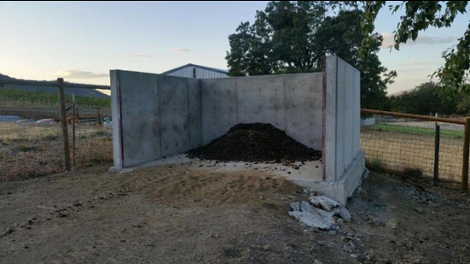
Manure Storage and Composting
Storing and composting manure reduces water pollution resulting from livestock waste (E. coli, nutrients)
Produces a valuable soil amendment that provides slow-release available nutrients and improves soil water holding capacity
Breaks up insect pest reproduction cycles, alleviating insect pressure to livestock

Slide 22
Irrigation Infrastructure Condition
We asked landowners in the NWQI project area to rank the condition of their irrigation infrastructure (sprinkler or flood).
Here is what you and your neighbors have told us so far:

Slide 23
What is an Irrigation Improvement Project?
New Installations: Upgrades from inefficient irrigation systems to more efficient systems through cost share programs. Large Capital. New sprinklers.
i.e. wild flood irrigation (~40% efficient) to sprinkler irrigation (~70% efficient).
Existing System Improvements: Upgrades of existing systems to promote energy and water conservation and improved water quality
Pipe or line leaky/unstable canals and ditches, fix diversions and turnouts, add measurement devices and controls.
Manage flood irrigation runoff to keep it as clean as possible
Notes:
We get around 30 clients a year requesting assistance for irrigation improvement.
New installation may be recommended for those who flood irrigate
Existing improvements may be made for those who have outdated sprinklers, leaky pipes, or who flood irrigate with aged infrastructure and don’t have the desire to switch to sprinkler
Want to see a reasonable efficiency gain for each project and there are many ways to quantify this effieciency gain on a per project basis.
Irrigation improvement projects have many values besides water use efficiency improvements

Slide 24
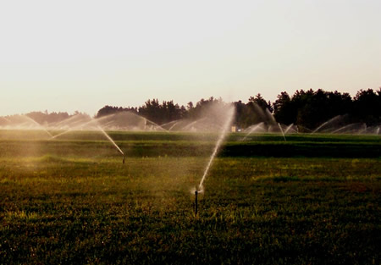
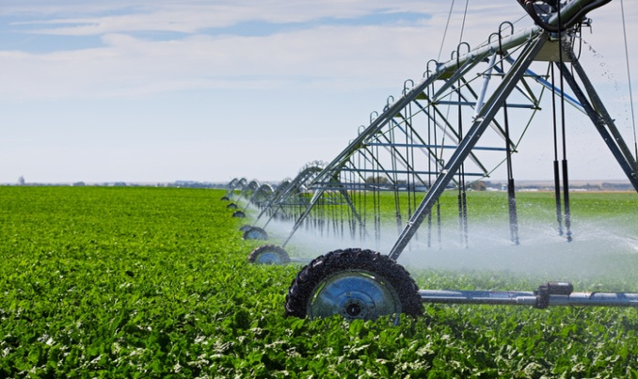
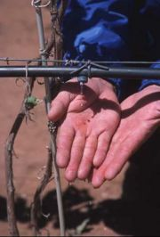
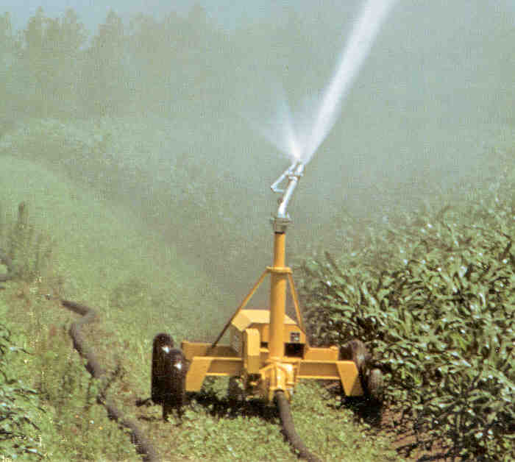
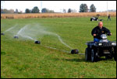
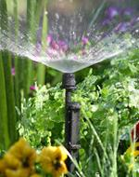
Irrigation Types in Jackson County
Notes:
Flood irrigation is still widely used in jackson county, but all irrigation types are seen, depending on landscape, soil type, and crop type, and manager pocketbook. Various systems have been installed as part of our projects as an upgrade from flood irrigation.
Wheel lines on Hay/pasture, drip and micro sprinklers on vineyards, orchards and hemp. Big guns on pasture/hay and center pivot/linear move on hay/pasture or vegetables

Slide 25
Ditch Improvement Options
Lined ditch, piped ditch, pressurized system, pumping?
Irrigator preference or past experience
Material cost, installation cost
Lifespan and maintenance
Contractor experience and preference
DIY vs professional installation
Buried Pipe is considered the most efficient, least maintenance, longest lifespan.

Slide 26
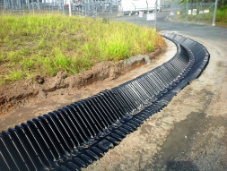
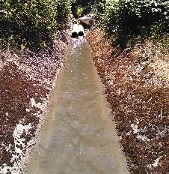
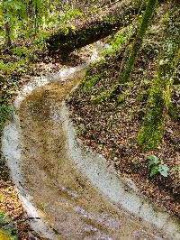
Ditch Lining Options
HDPE Rigid Liners
Flexible Liners – Plastic, Rubber
Concrete or Shotcrete
Clay or Bentonite

Slide 27
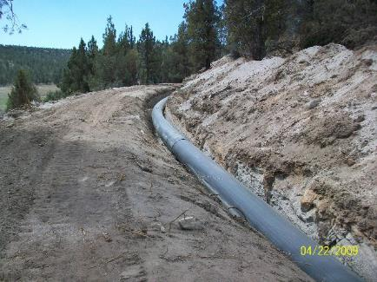
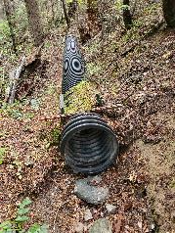
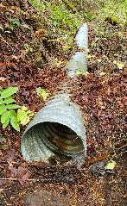
Piping Options
HDPE – Solid Wall
Fusion welded
HDPE – Corrugated
Single Wall
Double Wall – Smooth inside
CMP
Corrugated Metal Culvert Pipe
PVC
Gasket
Solvent Weld
Concrete Tile

Slide 28
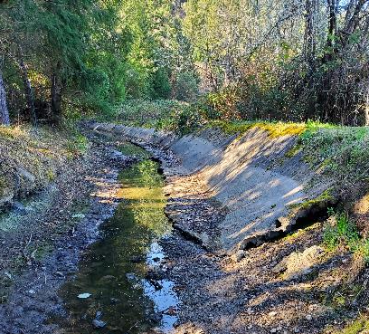
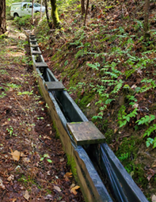

Slide 29
Irrigation Improvement Projects Can Provide Economic Benefits
Ability to grow a larger variety of crops with improved irrigation infrastructure
Cash crops, fruit, vegetables, orchard
Farm for profit
Improved crop yields
Up to ~30% yield increase when switching from wild flood to sprinkler system on hay in this area.
significant yield increases when intensively managing flood irrigation
Improved real estate value of property
Labor savings
Economics for pumped sprinklers (high electrical costs) sometimes doesn’t work for hay/pasture. Gravity pressure tends to pay off.
Notes:
Economic benefits play a major role in helping to keep ranches and agricultural land viable for future generations.
There can be no stewardship without production. A ranch must not go bankrupt as a result of costs incurred by the irrigation improvement project. It is up to the Ranch, however, to spearhead the economic questions and evaluations, as it take a lot of time and a lot of information to make a detailed economic analysis. If the rancher is not willing to do the economic analysis, we can only estimate the annual costs of the irrigation system and take an educated guess at improved forage yields, etc.

Slide 30
Irrigation Improvement Projects Can Provide Environmental Benefits
Improve water quality in nearby streams
Reduce Sediment, nutrients, bacteria, temperature
Reduce noxious weeds
Yellow star thistle, rushes, blackberry, etc.
Improve soil health
Reduce erosion
Increase water quantity
Amount available for in-stream habitat enhancement
Reduce pollution and save energy
Notes:
Improve water quality by eliminating tailwater runoff which carries, warm, sediment and bacteria-laden water into the nearby creeks, tributaries and rivers
Reduce noxious weeds through the improvement of water distribution by reducing wet and dry areas which can harbor invasive species like blackberry and yellow star thistle
Water quantity savings by switching from a flood to sprinkelr system may not provide water for in-stream use. It typically provides extra water for the farmer to irrigate with and grow more crops. The in-stream water amount is gained more from conveyance improvement projects such as piping a leaky canal or ditch.

Slide 31
Public Funding for Irrigation Projects
Typically the following criteria should be met for use of public funding related to irrigation projects:
Economical, Environmental, Social
Improve local food/fiber production potential
Improved irrigation efficiency/crop water productivity
Reduce potential hazards to public infrastructure caused by irrigation infrastructure failures and canal/ditch blowouts
Improve quality of flood irrigation water return flow/tailwater
Improve soil health for drought resilience. Reduce soil loss from erosion.
Improve stream flows and improve water availability on-farm.

Slide 32
Irrigation Project Costs
Grant funds, from JSWCD, NRCS and others can pay for a significant amount of the project cost. 10 – 50% is a reasonable estimate based on previous projects and depending on project type.
Up to $5,000 to $10,000 per acre (total) for new pump and sprinklers and labor.
Less for on-farm flood irrigation adjustments and tailwater management systems
Piping small/medium ditches can be $35 to $200 per foot material and labor (total)

Slide 33
JSWCD and NRCS Working Together: NRCS EQIP Program

Slide 34
Water Quality Benefits from Previous Project
Converted 72 Acres from wild flood to sprinkler irrigation
~12 Million gallons more water was used on the field for increased crop production. Per irrigation cycle, due to the increased efficiency.
~600 Million BTU’s less of thermal loading entering the stream, per irrigation cycle. Meaning the stream stayed colder and improved water quality.
Improved pasture and hay condition
Notes:
The irrigation improvement project had the following water quality results.
Millions of gallons less of polluted water entering back into Little Butte Creek, carrying with it millions of BTU’s of thermal energy.
There wasn’t any water placed instream for this project.

Slide 35
Process for Interested Landowners
Rogue NWQI Project
Contact project partners (JSWCD, NRCS, RRWC)
Technical assistance
Site visit
Resource concern assessment
Conservation plan for property
Funding
Apply in 2023
Implementation funding available 2024

Slide 36
Contacts
Jackson Soil and Water Conservation District
Meghan Montgomery, 541-423-6169
Paul DeMaggio, 541-423-6179
Clint Nichols, 541-423-6180
Natural Resource Conservation Service
Pete Winnick, 541-423-6174
Rogue River Watershed Council
John Speece, 541-423-6184
Crystal Nichols, 541-423-6185

